Slide 1
Introduction to Apache Spark
Pravin Y Pawar

Slide 2

What?
Apache Spark is
a fast and general-purpose cluster computing system
Extending popular MapReduce model to support more types of computations
introduced by Apache Software Foundation for speeding up the Hadoop computational computing software process
in-memory cluster computing that increases the processing speed of an application
System which can cover large number of workloads like batch, streaming etc.
Designed to be highly accessible, offering simple APIs in Python, Java, Scala and SQL and rich built-in libraries
Easy to integrate with other big data tools

Slide 3
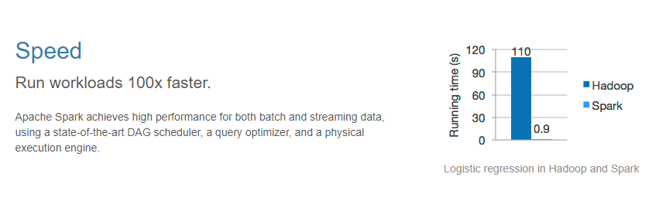
Execution Speed
Source : https://spark.apache.org/

Slide 4
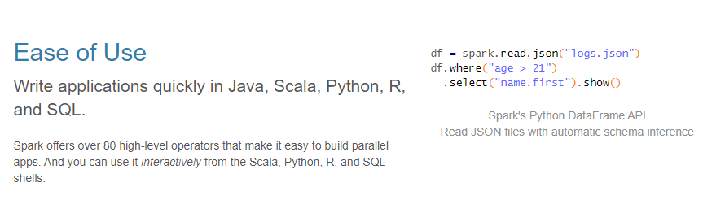
Ease of Use
Source : https://spark.apache.org/

Slide 5
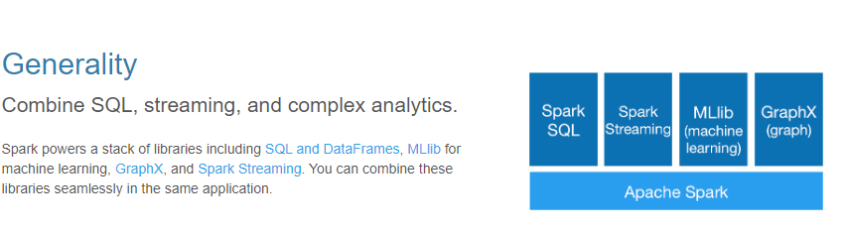
Generality
Source : https://spark.apache.org/

Slide 6
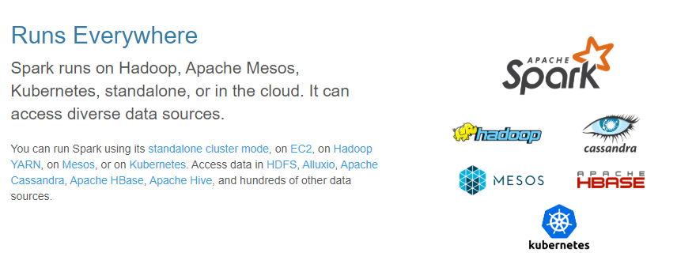
Runs Everywhere
Source : https://spark.apache.org/

Slide 7
Cluster Manager Types
The system currently supports several cluster managers:
Standalone
a simple cluster manager included with Spark that makes it easy to set up a cluster.
Apache Mesos
a general cluster manager that can also run Hadoop MapReduce and service applications.
Hadoop YARN
the resource manager in Hadoop 2.
Kubernetes
an open-source system for automating deployment, scaling, and management of containerized applications.
Source : https://spark.apache.org/

Slide 8
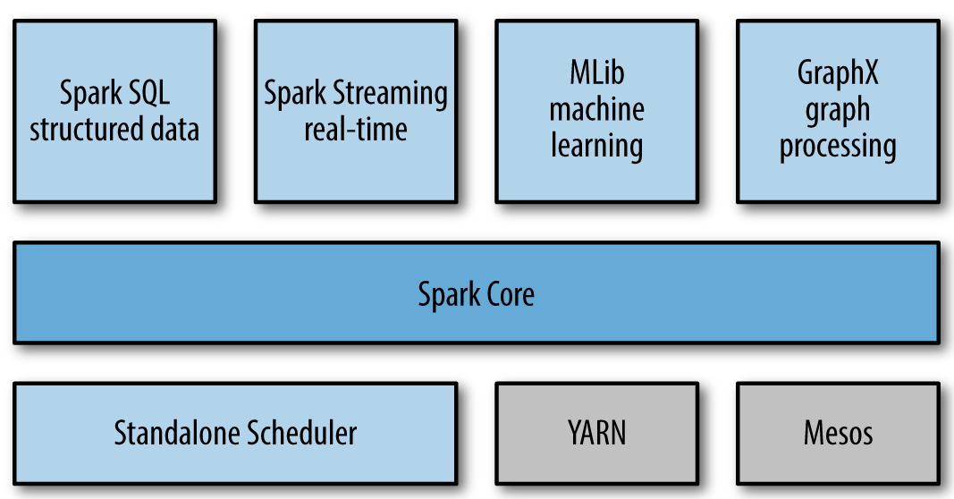
Unified Stack
Ref : https://www.oreilly.com/library/view/learning-spark/9781449359034/ch01.html

Slide 9
Spark Core
Contains the basic functionality of Spark, including components for
task scheduling
memory management
fault recovery
interacting with storage systems etc.
Home to the API that defines resilient distributed datasets (RDDs), which are Spark’s main programming abstraction
Provides many APIs for building and manipulating these collections

Slide 10
Spark SQL
Spark’s package for working with structured data
Allows querying data via SQL as well as the Apache Hive variant of SQL—called the Hive Query Language (HQL)
Allows developers to intermix SQL queries with the programmatic data manipulations supported by RDDs in Python, Java, and Scala, all within a single application
Tight integration with the rich computing environment provided by Spark makes Spark SQL unlike any other open source data warehouse tool

Slide 11
Spark Streaming
Spark component that enables processing of live streams of data
Examples of data streams include web servers log files
Provides an API for manipulating data streams that closely matches the Spark Core’s RDD API
Designed to provide the same degree of fault tolerance, throughput, and scalability as Spark Core.

Slide 12
MLlib
Built in library containing common machine learning (ML) functionality
Provides multiple types of machine learning algorithms, including
Classification
Regression
Clustering
collaborative filtering
supporting functionality such as model evaluation and data import
Provides some lower-level ML primitives, including a generic gradient descent optimization algorithm
All of these methods are designed to scale out across a cluster.

Slide 13
GraphX
Library for
manipulating graphs (e.g., a social network’s relations graph)
performing graph-parallel computations.
Extends the Spark RDD API, allowing us to create a directed graph with arbitrary properties attached to each vertex and edge
Provides
various operators for manipulating graphs (e.g., subgraph and mapVertices)
library of common graph algorithms (e.g., PageRank and triangle counting)

Slide 14
Cluster Managers
Spark is designed to efficiently scale up from one to many thousands of compute nodes
Can run over a variety of cluster managers, including
Hadoop YARN
Apache Mesos
Simple cluster manager included in Spark itself called the Standalone Scheduler
If you are just installing Spark on an empty set of machines
the Standalone Scheduler provides an easy way to get started
If you already have a Hadoop YARN or Mesos cluster,
Spark’s support for these cluster managers allows your applications to also run on them

Slide 15
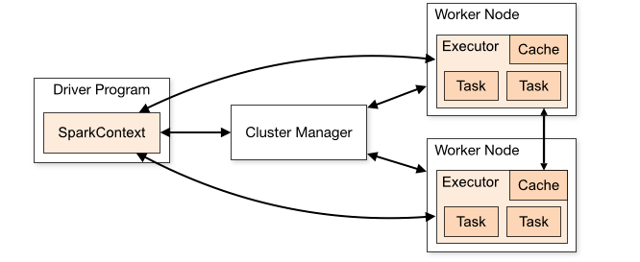
Cluster Mode Overview
Components
Source : https://spark.apache.org/docs/2.4.4/cluster-overview.html

Slide 16
Cluster Mode Overview (2)
Spark applications run as independent sets of processes on a cluster, coordinated by the SparkContext object in your main program (called the driver program).
Specifically, to run on a cluster, the SparkContext can connect to several types of cluster managers (either Spark’s own standalone cluster manager, Mesos or YARN), which allocate resources across applications.
Once connected, Spark acquires executors on nodes in the cluster, which are processes that run computations and store data for your application.
Next, it sends your application code (defined by JAR or Python files passed to SparkContext) to the executors.
Finally, SparkContext sends tasks to the executors to run.
Source : https://spark.apache.org/docs/2.4.4/cluster-overview.html

Slide 17
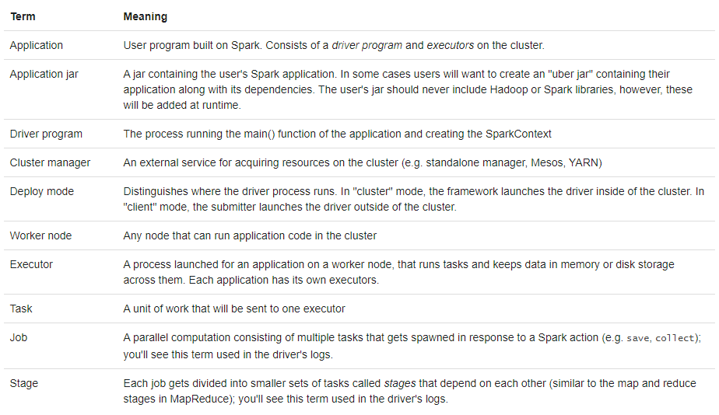
Spark Cluster Concepts
Source : https://spark.apache.org/docs/2.4.4/cluster-overview.html

Slide 18
Thank You!

